Slide 1
Detection of Distributed Denial of Service Attacks in SDN using Machine Learning Techniques
Project guide:
Dr. Manimekalai T
Project coordinators:
Dr. O. Uma Maheswari
Mrs. P. Steffi Snow
Ms..K.Lakshmipriya
Department of ECE
College of Engineering,Guindy
Presented by:
Shwetha A - 2019105576
Harini V - 2019105013
Yamini K - 2019105605
Jayaashree P - 2019105541

Slide 2
OBJECTIVE
Distributed Denial of Service attacks (DDoS) are one of the most rampant attacks that can interrupt the functionality of the network and make most of the network services unreachable for network users.
The efficient identification of DDoS attacks on SDN environments is still a challenge because of the number of network features considered.
The SDN enables the network operators to manage the overall network consistently and holistically, regardless of the complexity of infrastructure devices.
We would like to apply various machine learning Algorithms (Decision Tree, KNN, Random Forest, Neural Networks) to detect malicious traffic and to compare the accuracy and detection rate of machine learning algorithms with an enhancement over the recently developed DDoS detection systems in the SDN environment which is Mininet Virtual Machine.

Slide 3
MOTIVATION
Cloud computing technologies is booming with more and more demand for cloud services, many companies and organizations are moving their services to cloud in hope for a better performance and security.
Security measures needs to be in place to keep people’s personal data intact and secure from security network attacks.
DDOS attacks are on such network attacks which block access to the server and deny services for the cloud customers.
Many research and measures have been taken to prevent this from happening, one such measure is to use software defined networks to achieve this goal.

Slide 4
LITERATURE SURVEY
AUTHOR AND YEAR | PAPER TITLE | CONTRIBUTION
Mahmoud Said El Sayed , Nhien-An Le-Khac, Marianne A. Azer , and Anca D. Jurcut DECEMBER 2022 | A Flow-Based Anomaly Detection Approach With Feature Selection Method Against DDoS Attacks in SDN. | The key contribution of this work can be summarised as follows: 1.Two popular feature selection methods (IG and RF) are used to find the most relevant DDoS attack features in each dataset individually. 2.A DL based IDS process to detect DDoS in SDN. 3.Analysis the network performance of the DL model on the SDN controller.The result analysis shows that the DL approach does not significantly degrade the performance of the controller.
KSHIRA SAGAR SAHOO , BATA KRISHNA TRIPATHY ,KSHIRASAGAR NAIK, SOMULA RAMASUBBAREDDY,BALAMURUGAN BALUSAMY , MANJU KHARI , AND DANIEL BURGOS .July 29, 2020. | An Evolutionary SVM Model for DDOS Attack Detection in Software Defined Networks | The main contribution of the paper is given below: a. This work utilizes SVM technique as the prime classifier for predicting malicious traffic. b. The proposed detection approach combines SVM with KPCA and GA. Feature extraction has been carried out by KPCA, and SVM classifier is used for attack classification. c.. The attack detection results compared with other classifiers which show that the proposed SVM model performs effective and accurate classification than others.
Waheed G. Gadallah,Nagwa M. Omar Hosny M. Ibrahim. June 2021 | Machine Learning-based Distributed Denial of Service Attacks Detection Technique using New Features in Software-defined Networks | DDoS attack detection technique is implemented based on ML in the controller in the SDN environment. They use some efficient ML-based algorithms such as Naive Bayes, KNN, Decision Tree, and Random Forest, in addition to SVM to create classification models. The technique uses advancing new traffic-based flow features to create the model, which can classify SDN flow packets as normal or a DDoS attack. Features are gathered from traffic flow headers and statistics.

Slide 5
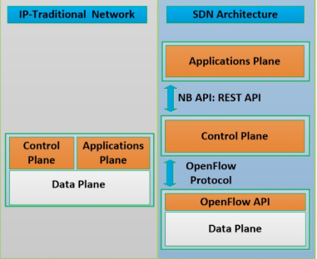
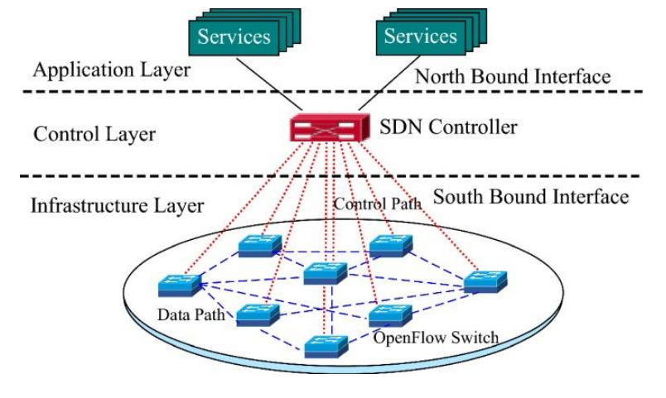
Traditional vs SDN Architecture

Slide 6
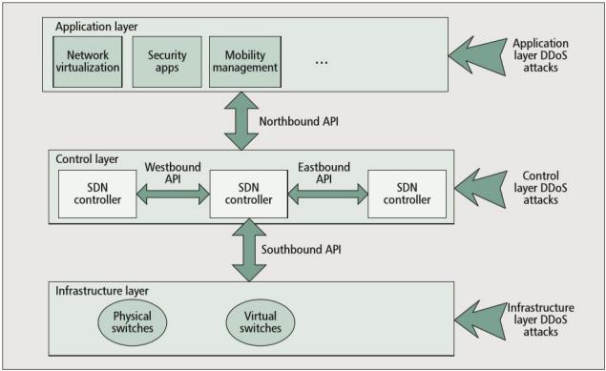
SDN architecture with vulnerabilities of DDOS attacks

Slide 7
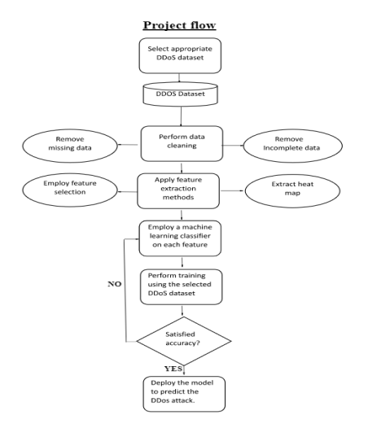
FLOW OF PROJECT WORK

Slide 8
DATA PRE-PROCESSING AND MODEL BUILDING
Data Cleaning: This involves handling missing values, removing duplicates, and dealing with inconsistent data.
Data Transformation: This involves scaling, normalization, and encoding categorical data.
Feature Selection: This involves selecting relevant features for the model to improve its performance.
Feature Engineering: This involves creating new features from existing data to improve model performance.
Splitting the data into training and testing sets: This helps evaluate the model's performance on unseen data.

Slide 9
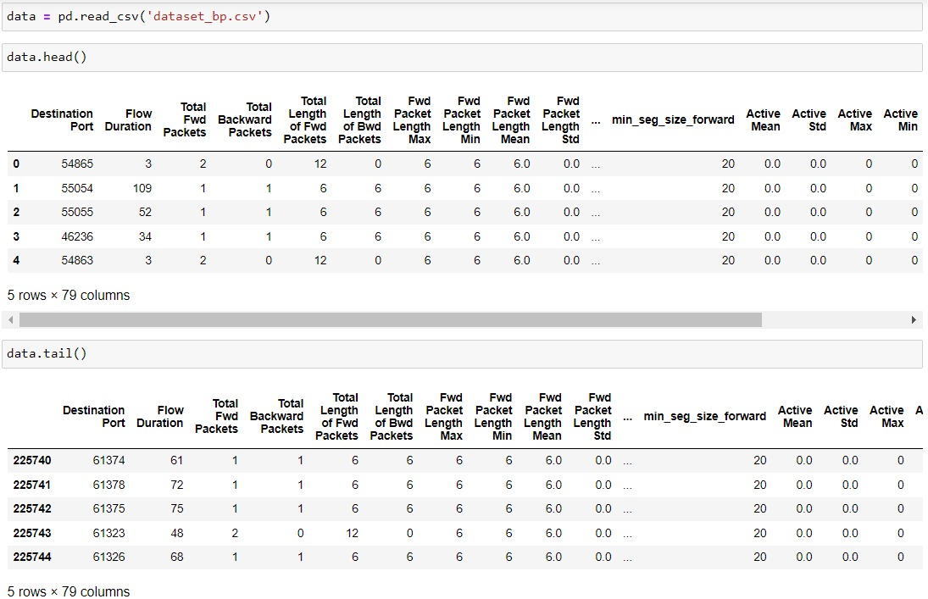

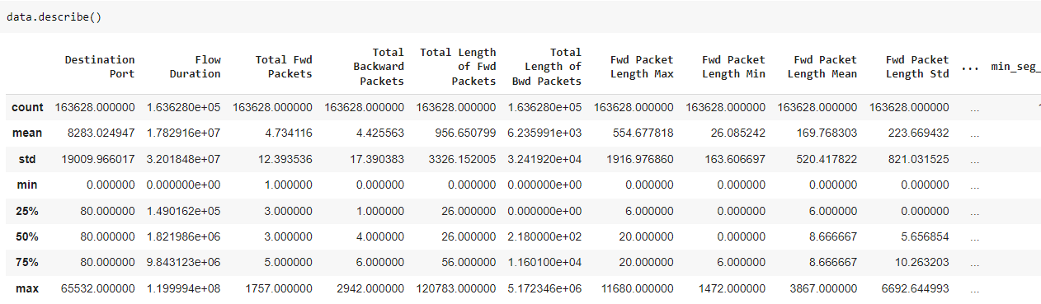
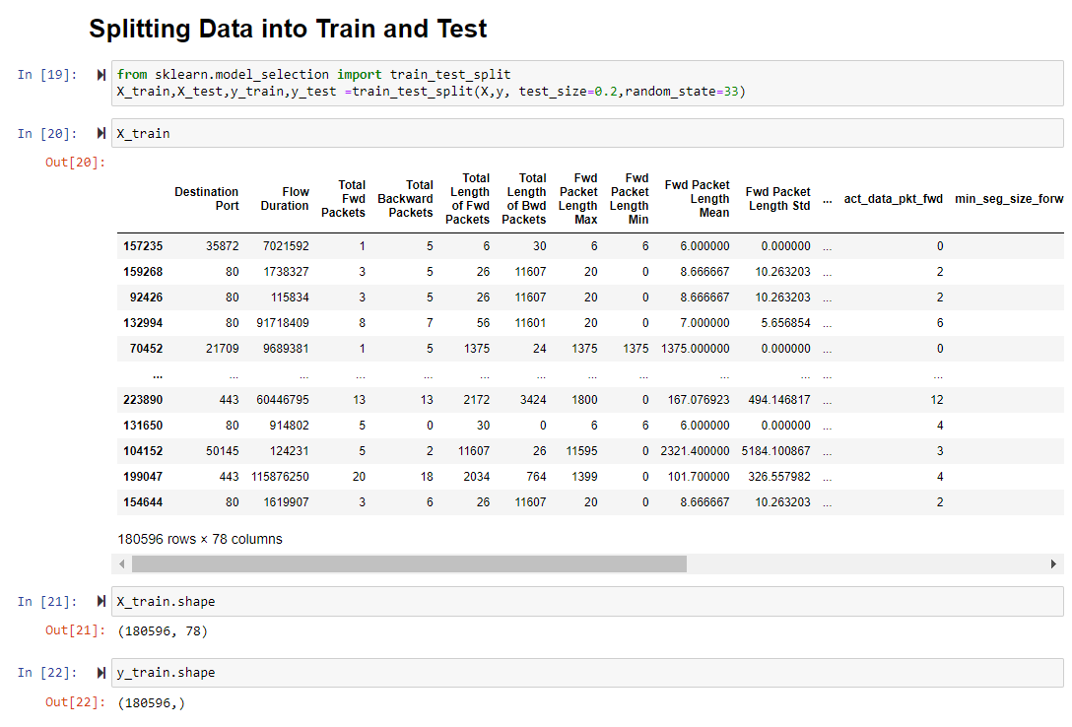

Slide 10
ACCURACY PROVIDED BY DIFFERENT ML ALGORITHMS
DECISION TREE | Success Accuracy = 99.97 %
LOGISTIC REGRESSION | Success Accuracy = 92.95 %
KNN | Success Accuracy = 97.87 %
RANDOM FOREST | Success Accuracy = 99.96 %
NAIVE BAYES | Success Accuracy = 76.56 %

Slide 11
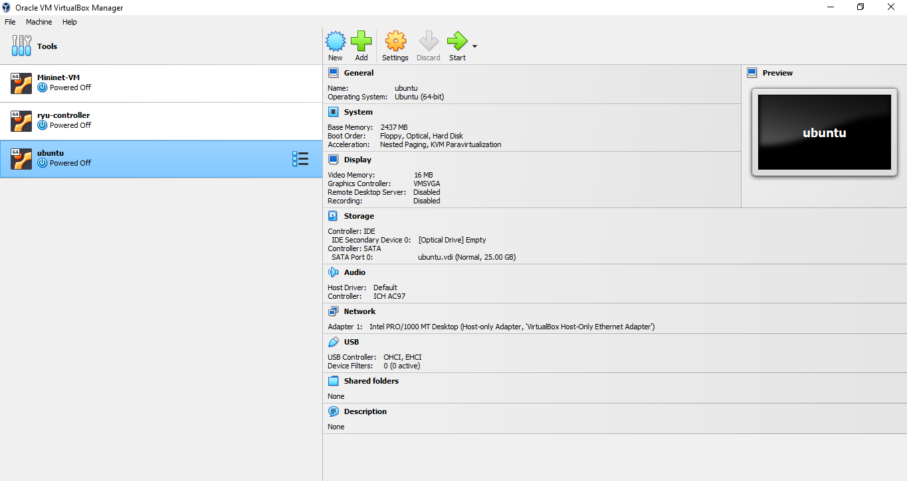
EXPERIMENTAL SETUP REQUIREMENT
SIMULATION SOFTWARE
MININET
OPERATING SYSTEM
UBUNTU
PLATFORM
VIRTUALBOX

Slide 12
RESULT
The dataset in the given reference paper has been taken and pre-processed.
Various machine learning algorithms have been applied to the pre-processed dataset to classify the DDoS traffic from normal traffic and accuracy of the models have been noted and compared with the base paper.
CONCLUSIONs
Accuracy of the Machine learning algorithms have been compared with the base paper and the results have been successfully replicated.

Slide 13
REFERENCES
1.Ahmad, I., Namal, S., Ylianttila, M. and Gurtov, A. (2015). Security in software defined networks: A survey, IEEE Communications Surveys Tutorials 17(4): 2317–2346. JCR Impact Factor: 22.973 (2019). Alshamrani, A., Chowdhary, A., Pisharody, S., Lu, D. and 2.Huang, D. (2017). A defense system for defeating ddos attacks in sdn based networks, Proceedings of the 15th ACM International Symposium on Mobility Management and Wireless Access, MobiWac ’17, Association for Computing Machinery, New York, NY, USA, p. 83–92. ERA Ranking: B.
2.A Flow-Based Anomaly Detection Approach With Feature Selection Method Against DDoS Attacks in SDNs.

